Slide 1

Customers Segmentation based on their Credit Card usage behavior:
Pari Manouchehri

Slide 2
Project Outline:
Introduction
Objective
EDA
Cleaning Dataset
Analyze Features
Feature Engineering
Applying Dimensional Reduction
Clustering Methods
Kmeans Clustering
Hierarchical Clustering
Clustering with Gaussian Mixture Models (GMM)
Conclusion
Future Work
Density-Based Spatial Clustering of Applications with Noise (DBSCAN)

Slide 3
Introduction:
Objective:
Customer Segmentation by using Customer Behaviors in order to Define a Proper Marketing Strategy.
The dataset used for this analysis was taken from Kaggle dataset.
Dataset contains credit card usage of customers with 18 behavioral features.
Segmentation of customers can be used to define marketing strategies.
The dataset summarizes the usage behavior of about 9000 active credit card holders during the last 6 months which is updated 2 years ago.
Customer segments enable you to understand the patterns that distinguish your customers.

Slide 4
Exploratory Data Analysis(EDA)

Slide 5
Data Cleaning Summary:
Filling Missing Values
1
Removing Outlier By Zscore
2
Preparing Dataset by using Standardize
3

Slide 6
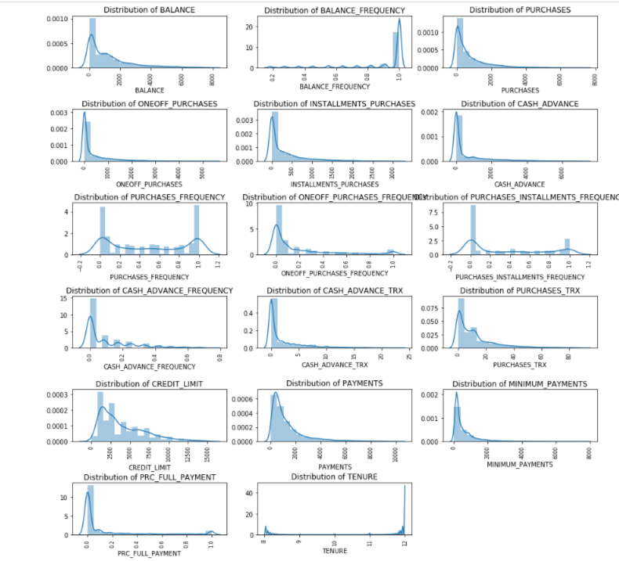
Distribution of Features

Slide 7
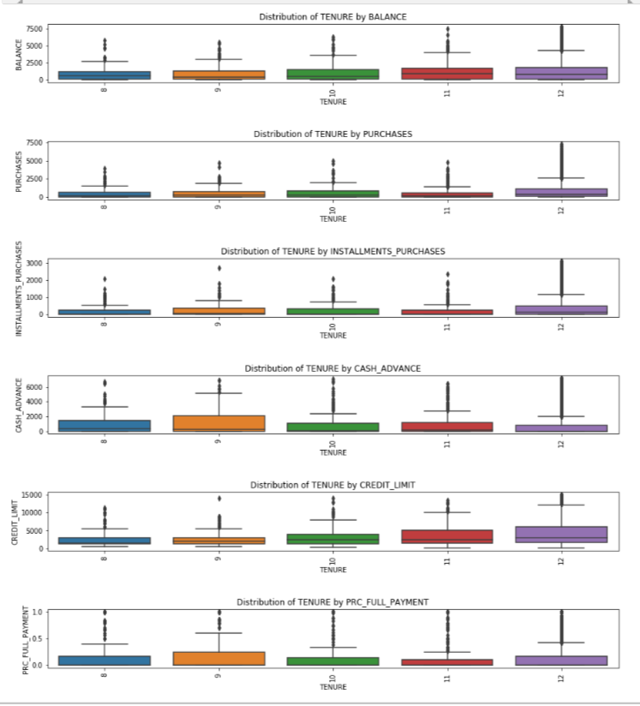
Distribution of TENURE by some Features

Slide 8

Feature Engineering

Slide 9
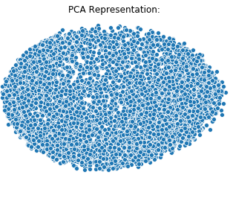
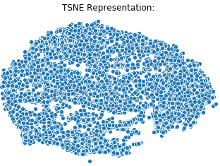
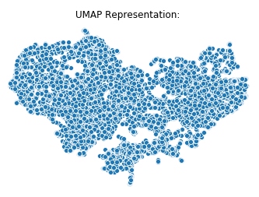
Visualize by using Dimensionality Reduction
Applying Dimensionality Reduction:
Principal Components Analysis (PCA)
t-Distributed Stochastic Neighbor Embedding (t-SNE)
Uniform Manifold Approximation and Projection (UMAP)

Slide 10
Dimensional Reduction Results:
The percentage of total variance in the dataset explained by each component from PCA is around 0.47.
In PCA time elapsed is much less than TSNE and UMAP. Also, UMAP time elapsed is much less than TSNE.
In UMAP we can identify classes quite well in contrast to TSNE and PCA representation.

Slide 11
Clustering Methods

Slide 12
Kmeans Clustering

Slide 13
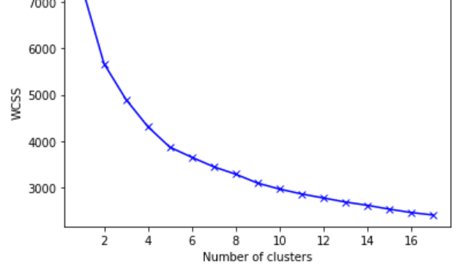
Elbow Method:
Finding the Best Number of Clusters with Elbow Method:

Slide 14
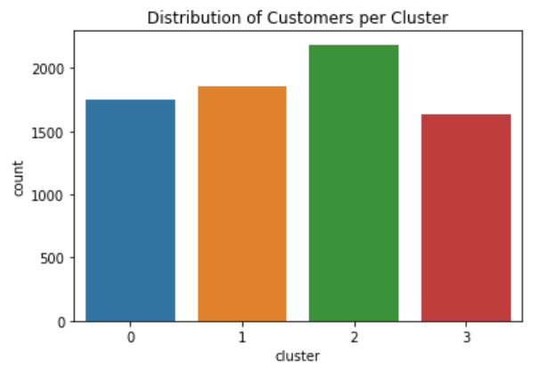
Distribution of Customers per cluster

Slide 15
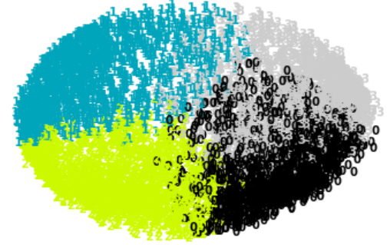
Plot Kmeans with 4 Clusters by PCA

Slide 16
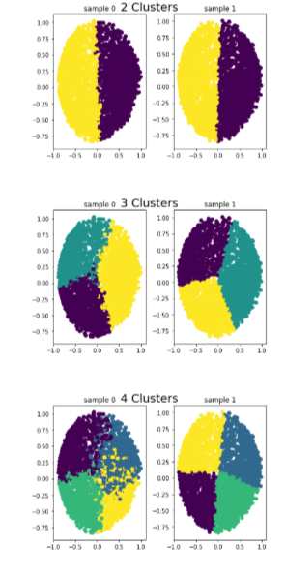
Observe Consistency across Subsamples of Kmeans Clustering

Slide 17
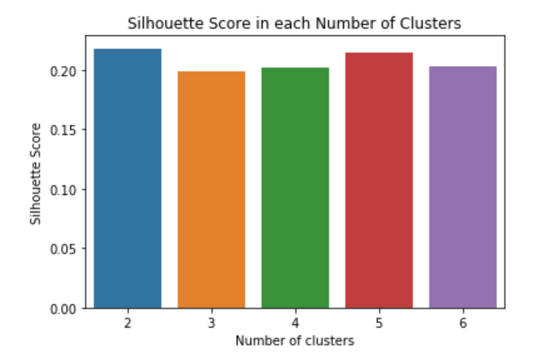
Finding best number of Clusters by Calculating Silhouette Score
The best solution is for the 2 clusters as its silhouette score is the highest.

Slide 18
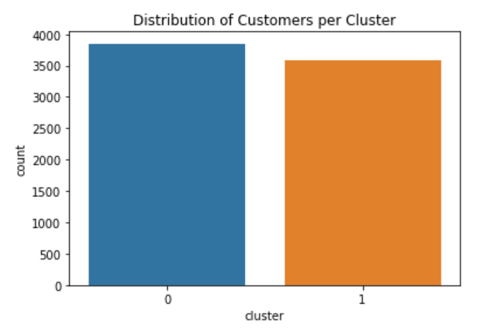
Kmeans Clustering with High Silhouette Score

Slide 19

Hierarchical Clustering

Slide 20
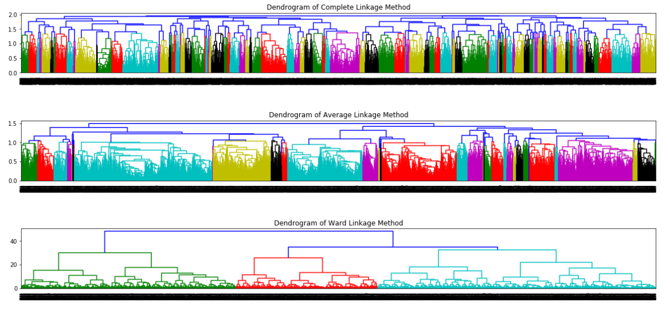
Sketch the dendrogram using the different linkage method

Slide 21
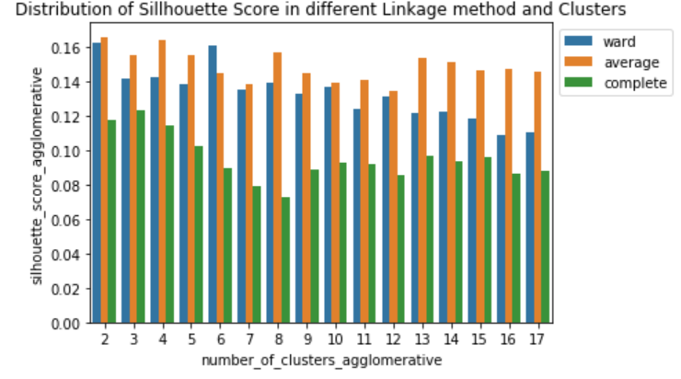
Finding best number of Clusters by Calculating Silhouette Score
The highest number of silhouette score is for number of clusters 2 with Average linkage method.
Based on the dendogram, the ward linkage has better distribution, so we choose the ward one with 2 clusters.

Slide 22
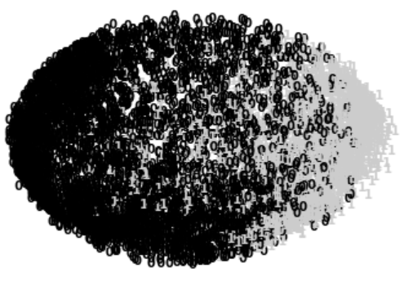
Plot Hierarchical with 2 Clusters by PCA

Slide 23
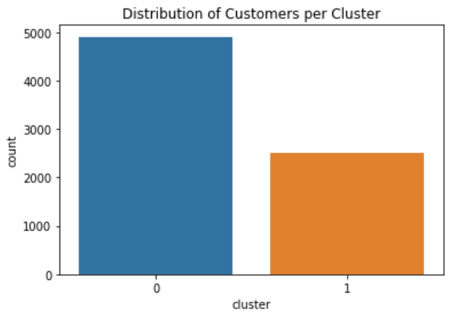
Hierarchical Clustering with High Silhouette Score

Slide 24
Density-Based Spatial Clustering of Applications with Noise (DBSCAN)

Slide 25
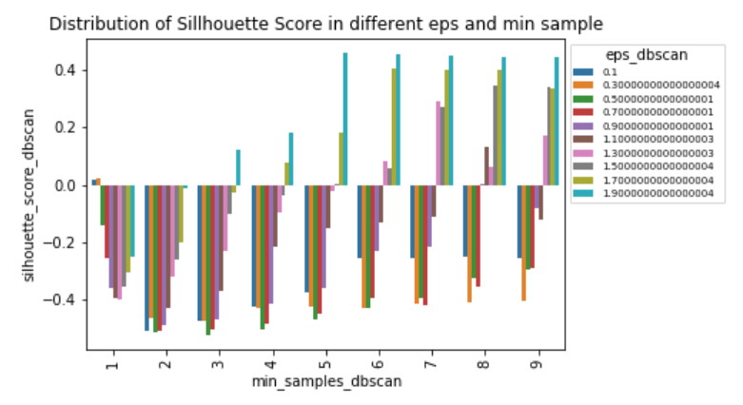
Finding best number of Clusters by Calculating Silhouette Score
The highest number of silhouette score is for 5 min_ sample and eps:1.9 with 2 clusters

Slide 26

Plot DBSCAN with 2 Clusters by PCA
Result does not seem a suitable method because all number of customers in the one cluster and distribution of variables is not homogenous.

Slide 27
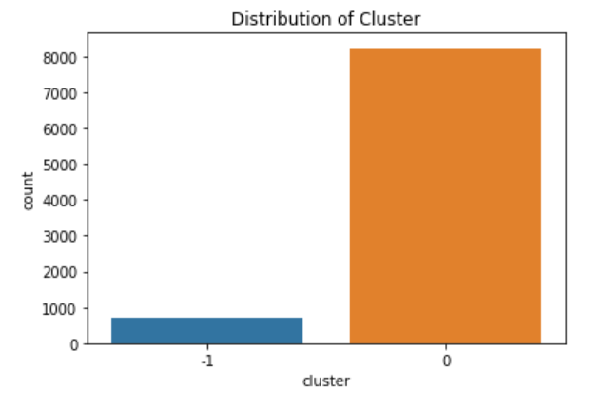
DBSCAN Clustering with High Silhouette Score

Slide 28
Clustering with Gaussian Mixture Models (GMM)

Slide 29
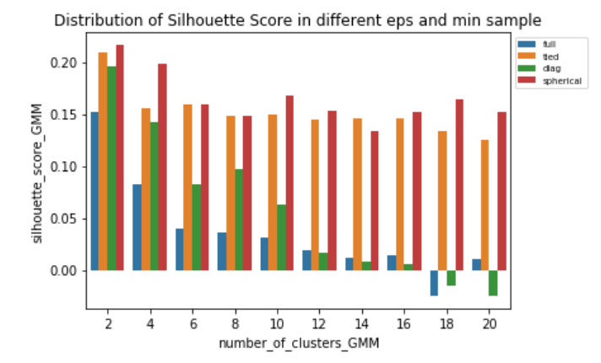
Finding best number of Clusters by Calculating Silhouette Score
The highest Silhouette Score is for number of 2 clusters and covariance_type of Sherical.

Slide 30
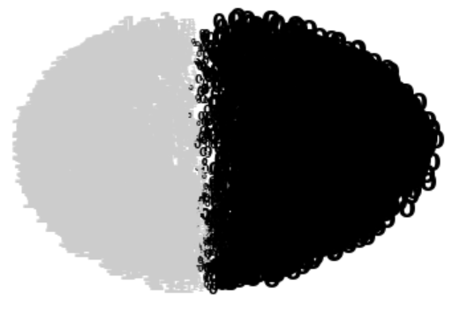
Plot GMM with 2 Clusters by PCA with size-based probability

Slide 31
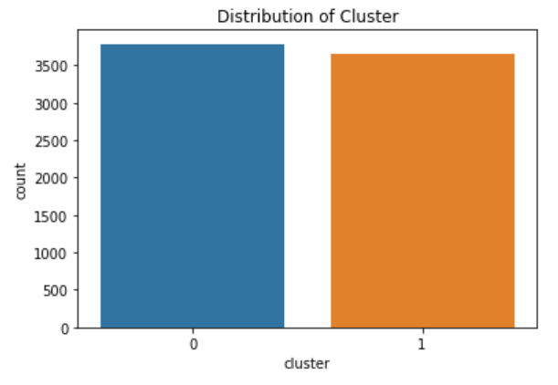
GMM Clustering with High Silhouette Score

Slide 32
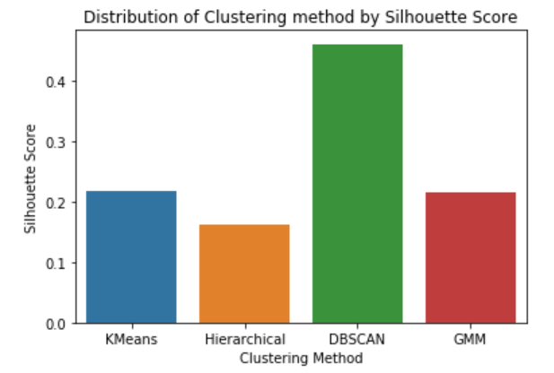
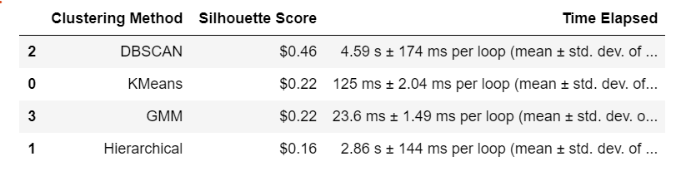
Compering Results of Methods to Find the Optimal Number of Cluster Model

Slide 33
Results of Comparing Mrthods:
Evaluating model with the highest silhouette score metric to choose the best method does not seem a suitable one for DBSCAN model even with a high score.
This is because most of the customers clustered in the one cluster and the lower number of variables are as an outlier, so density is very much in the first cluster.
The Second Highest Silhouette Score is for Kmeans and GMM.

Slide 34
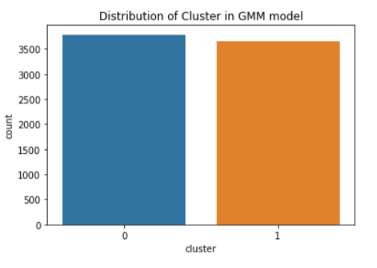
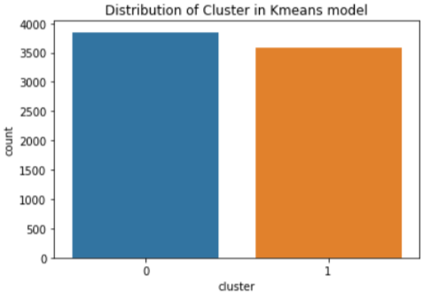
Comparing Kmeans and GMM Clustering method in terms of Customer Distribution per Cluster:
Kmeans:
GMM:

Slide 35
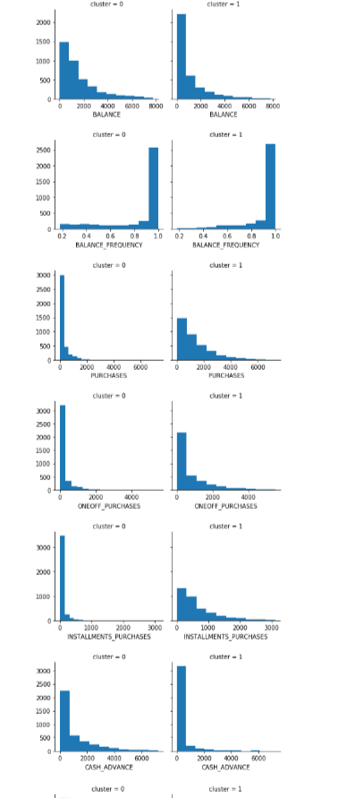
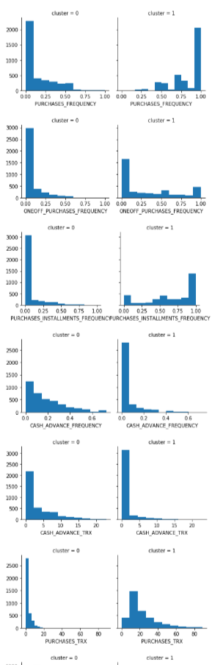
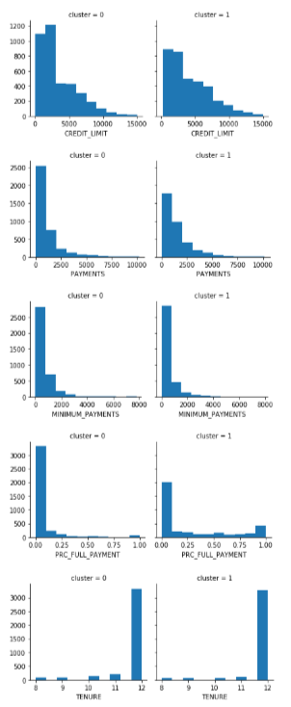
Kmeans Clustering Interpretation

Slide 36

Kmeans Clustering Results:
According to the results:
Cluster 0: Indicates a group of customers who have a higher BALANCE and CASH_ADVANCE with low PURCHASES and PURCHASES_FREQUENCY. We can assume that these customers with least usage of credit card. The number of customers in this cluster is a bit higher.
Cluster 1: Indicates a group of customers who have high PURCHASES and PURCHASES_FREQUENCY . We can assume that these customers with more usage of credit card and makes more frequent purchases.

Slide 37
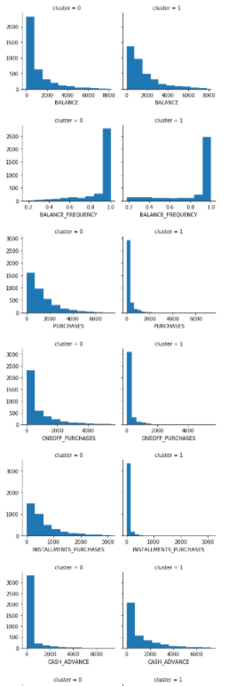
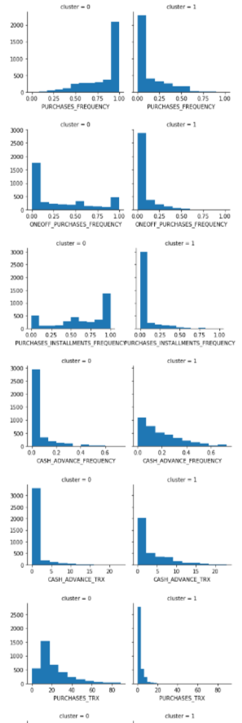
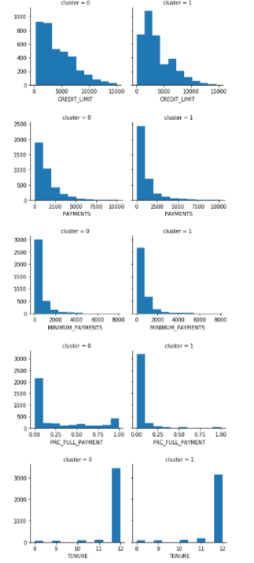
GMM Clustering Interpretation

Slide 38

GMM Clustering Result:
Cluster 0: Indicates a group of customers who have a low BALANCE and CASH_ADVANCE with high CREDIT_LIMIT, PURCHASES. We can assume that these customers with high usage of credit card. The number of customers in this cluster is a bit higher, which is good.
Cluster 1: Indicates a group of customers who have a high BALANCE and CASH_ADVANCE with low PURCHASES and PURCHASES_FREQUENCY. We can assume that these customers with least usage of credit card. The number of customers in this cluster is a lower.

Slide 39
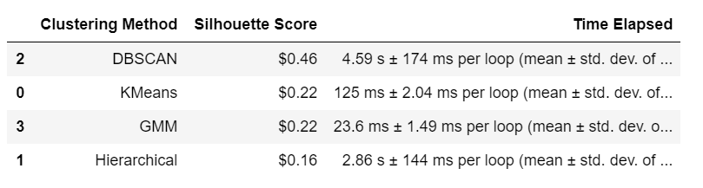
Comparing Kmeans and GMM Clustering method in terms of Time Elapsed
Time Elapsed in GMM method is much less than kmeans method.

Slide 40
Conclusion:
I chose the GMM model in contrast with Kmeans.
The variable distribution is better per cluster without density.
GMM Time Elapsed is much less.
GMM models have a better understanding of customer segmentation by using the 2 clusters model:
Cluster 0:
Indicates a group of customers who have a low BALANCE and CASH_ADVANCE with high PURCHASES.
We can assume that these customers with high usage of credit card.
The number of customers in this cluster is a bit higher.
This group can be the target for market research.
Cluster 1:
Indicates a group of customers who have a high BALANCE and CASH_ADVANCE with low PURCHASES.
We can assume that these customers with the least usage of credit card.
The number of customers in this cluster is a bit lower.
This group can be assumed for marketing strategies target, so we can use the behavior of clustering segmentation of zore from marketing research to encourage these customers for higher usage of credit card.

Slide 41
Future Works
Applying these models without removing outlier and comparing the result with this.
Quality of the dataset could have been improved as well, for example dataset including Age, Income, Sex, etc.
Analysis of the Credit Card usage behavior can be enriched to find the reason of Customers Segmentation.
More data can be added to the analysis to broaden conclusions.
Newer data can be helpful in drawing better conclusions.

